Slide 1
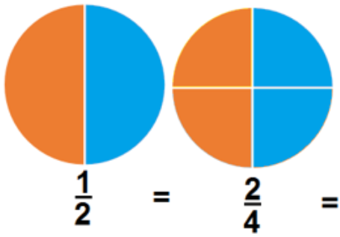
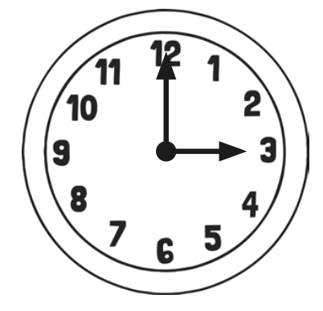
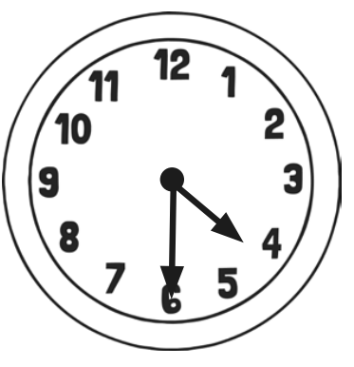
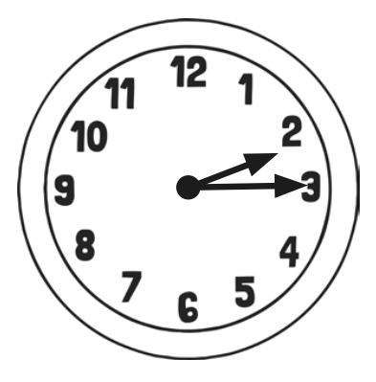
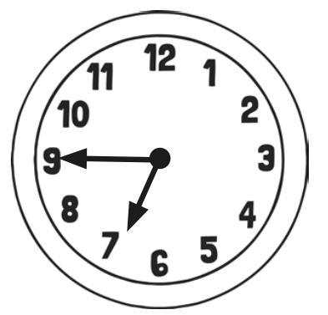
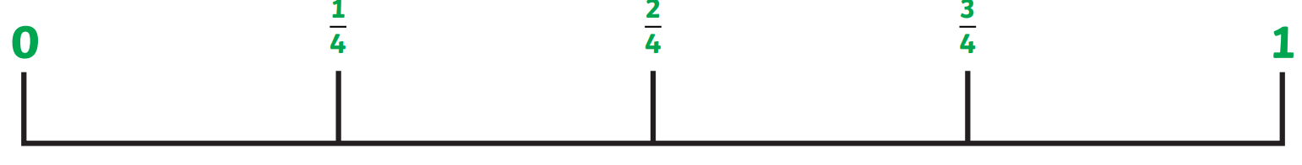
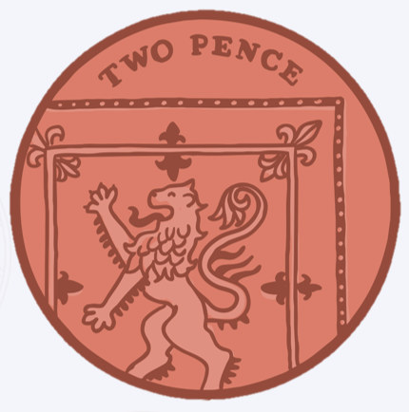
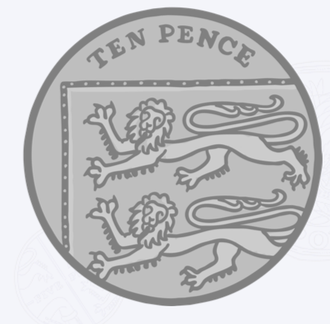
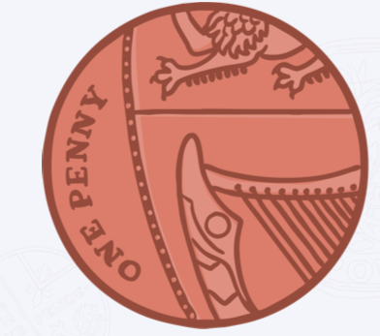
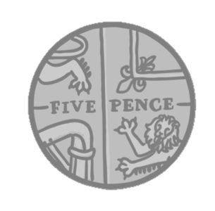
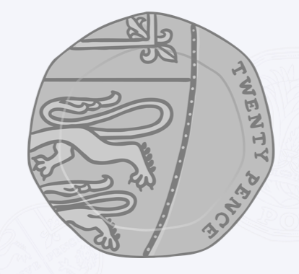
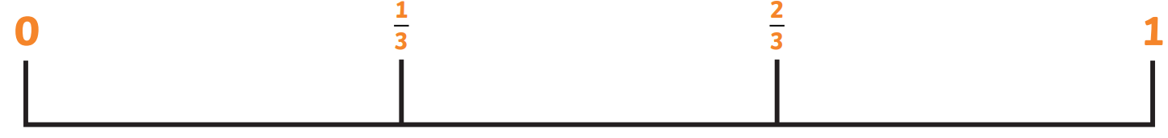
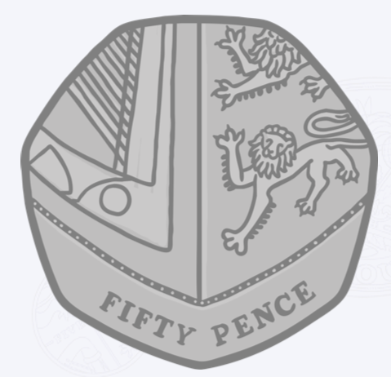
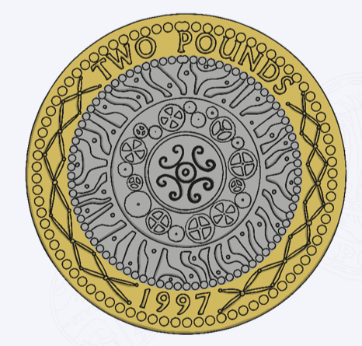
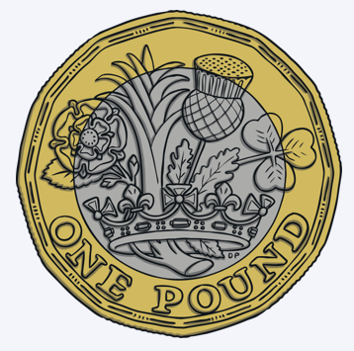
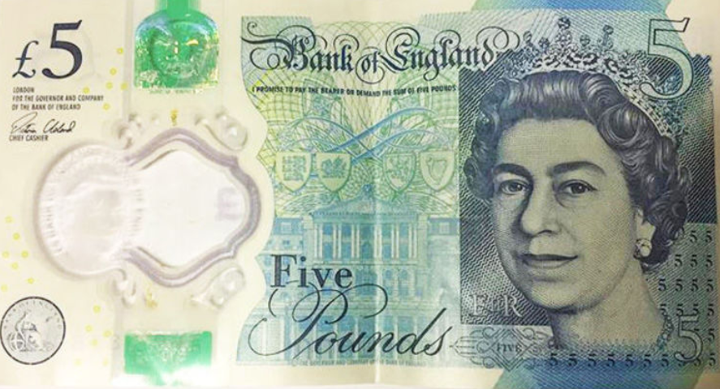
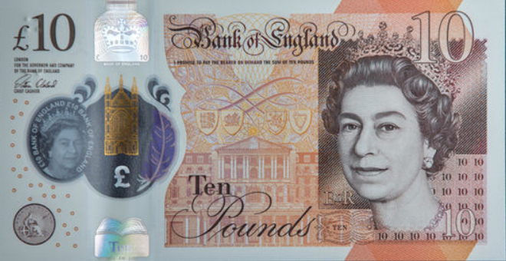
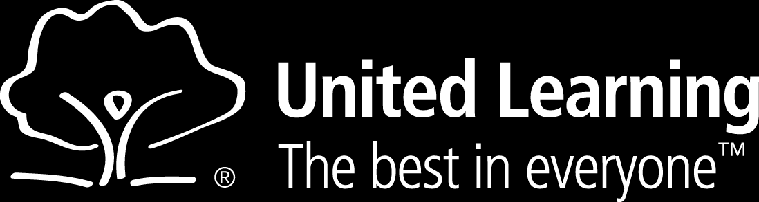
one half = two quarters
length | centimetres metres | cm m
weight mass | grams kilograms | g kg
capacity | millilitres litres | ml l
o’clock | half past
quarter past | quarter to
 | Greater than
 | Less than
 | Equals
>
Clockwise
<
60 seconds | = | 1 minute
60 minutes | = | 1 hour
24 hours | = | 1 day
Ones
one | 1
two | 2
three | 3
four | 4
five | 5
six | 6
seven | 7
eight | 8
nine | 9
Tens
ten | 10
twenty | 20
thirty | 30
forty | 40
fifty | 50
sixty | 60
seventy | 70
eighty | 80
ninety | 90
2D Shapes | Name | Sides | Vertices
 | Circle | 1 | 0
 | Square | 4 | 4
 | Rectangle | 4 | 4
 | Triangle | 3 | 3
3D Shapes | Name | Faces | Edges | Vertices
 | Cube | 6 | 12 | 8
 | Cuboid | 6 | 12 | 8
 | Sphere | 1 curved surface | 0 | 0
 | Pyramid | 5 | 8 | 5
One pence
1p
Two pence
2p
Five pence
5p
Ten pence
10p
Twenty pence
20p
zero
one
quarter
two
quarters
three
quarters
one
Fifty pence
50p
One pound
£1
Two pounds
£2
Five pounds
£5
Ten pounds
£10
zero
one
third
two
thirds
one

